Slide 1
The analysis of Russian strategic communication in years 2000-2024
Grzegorz Zbrzeżny, Izabela Telejko

Slide 2

Agenda
Introduction to the project
Dataset description
Data preprocessing
Exploratory Data Analysis
Final Solution

Slide 3
Introduction to the Project
Check the hypothesis that with the use of NLP we are able to do an analysis of Russian strategic communication addressed to and about a specific actors – Poland and whole Europe.
Using NLP techniques we wanted to look on the evolution of political language against the background of political changes and explore its predictive value.
Visualize the evolution of the Russian political language and examine evolution of the sentiment throughout the years.
Project conducted in collaboration with Centrum Dialogu im. Juliusza Mieroszewskiego.

Slide 4
Dataset Description
Data: Speeches of Vladimir Putin, authoritarian leader who has been in power for the last 25 years:
as president (2000-2008) and since 2012 until now,
as prime minister (2008-2012).
Source: official website of the Russian president.
Dataset prepared by our partners from Mieroszewski Center.
9,838 speeches delivered between the years 2000 and 2024.

Slide 5
Dataset Description
Speeches are in form of transcriptions which are translated to English.
Initial dataset is a list of JSON objects, where each JSON represents an individual speech and metadata with schema:
date of the speech,
place of the speech,
tags,
title,
filtered and unfiltered transcripts.

Slide 6
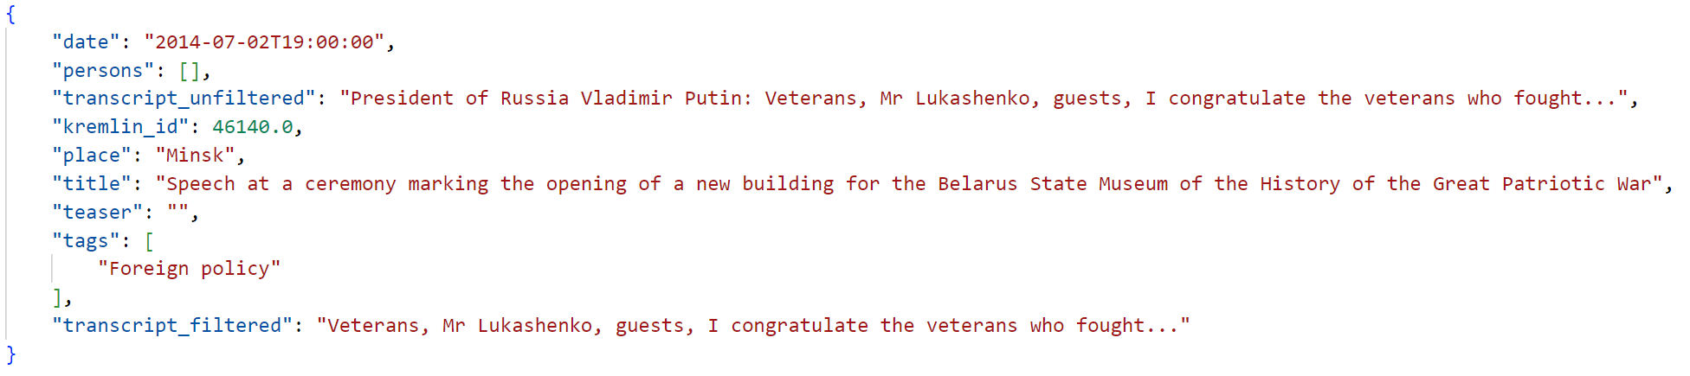
Sample Speech

Slide 7
Data Preprocessing
Steps of data processing:
Remove stop words using list of english stop words from nltk.corpus.
Take date and filtered transcript for each speech.
Remove punctuation and part of symbols from speeches’ texts (for instance #, …, or ’ ).
Tokenize and Lemmatize using SpaCy.
Final result is a dictionary in which:
keys: string with each month (e.g. ‘2001-01’)
values: list of processed speeches for given month

Slide 8
Exploratory Data Analysis
Basic statistics
Term | Count
russian | 229
russia | 227
relation | 156
people | 151
germany | 128
minister | 123
republic | 119
romania | 119
country | 117
president | 112
Average length of monthly speeches in token count: 489
Average token length: 6.41
Most common terms in speeches.

Slide 9
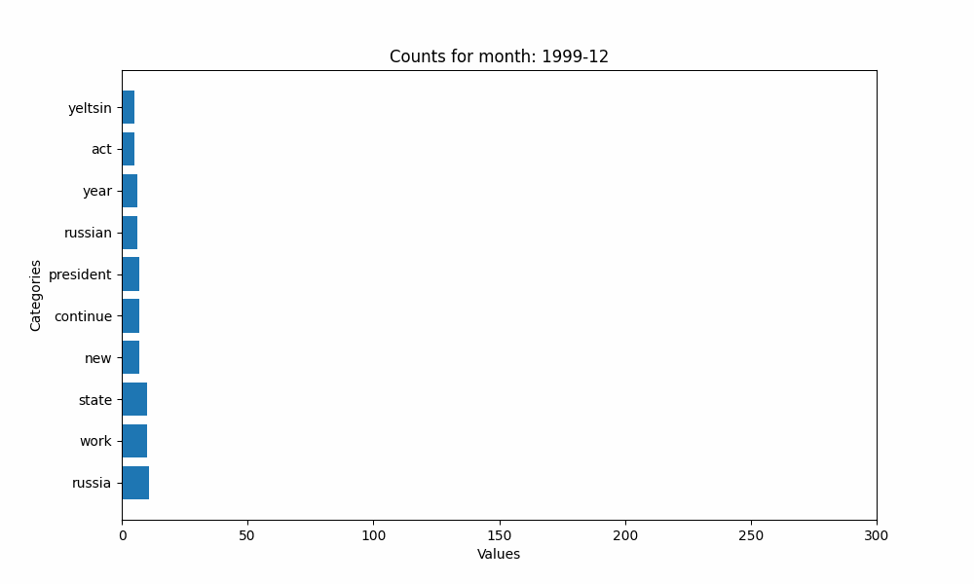

Slide 10
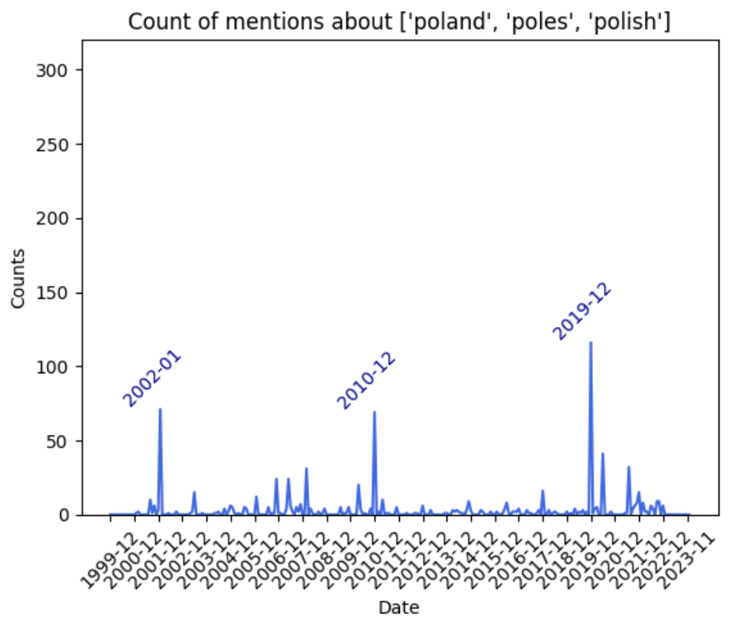
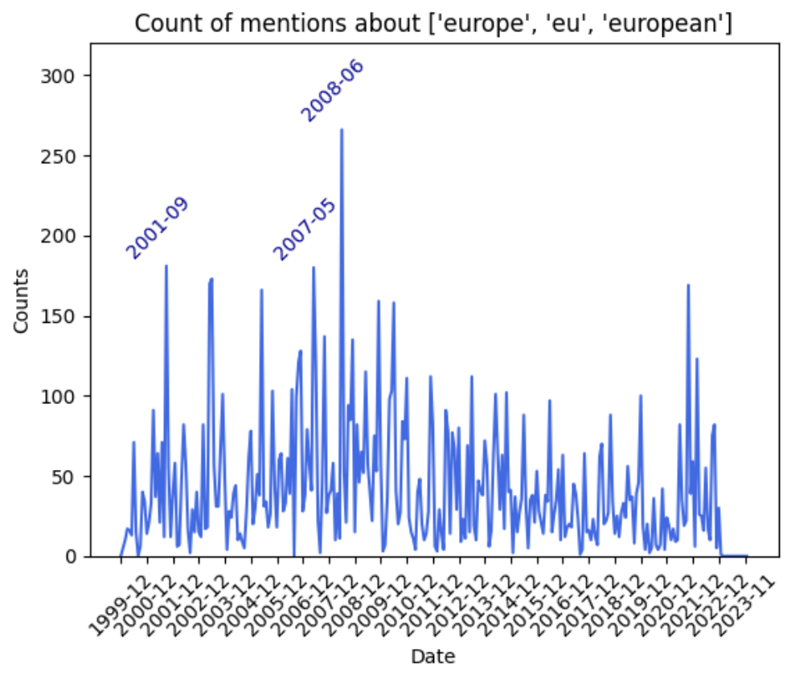

Slide 11
Sentiment Change in Speeches
Speeches split to chunks of size 256 tokens.
Model:
distilbert/distilbert-base-uncased-finetuned-sst-2-english,
binary classification between positive and negative sentiment,
Tokenizer tuned for this model.

Slide 12
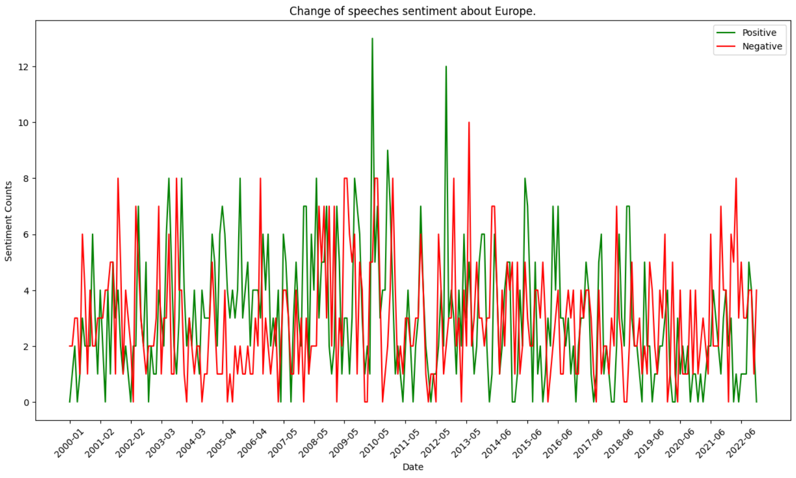
Sentiment Change in Speeches

Slide 13
Sentiment Change in Fragments About Poland
Text samples created based on appearance of Poland-related tokens
Model:
siebert/sentiment-roberta-large-english,
binary classification between positive and negative sentiment,
Tokenizer tuned for this model.

Slide 14
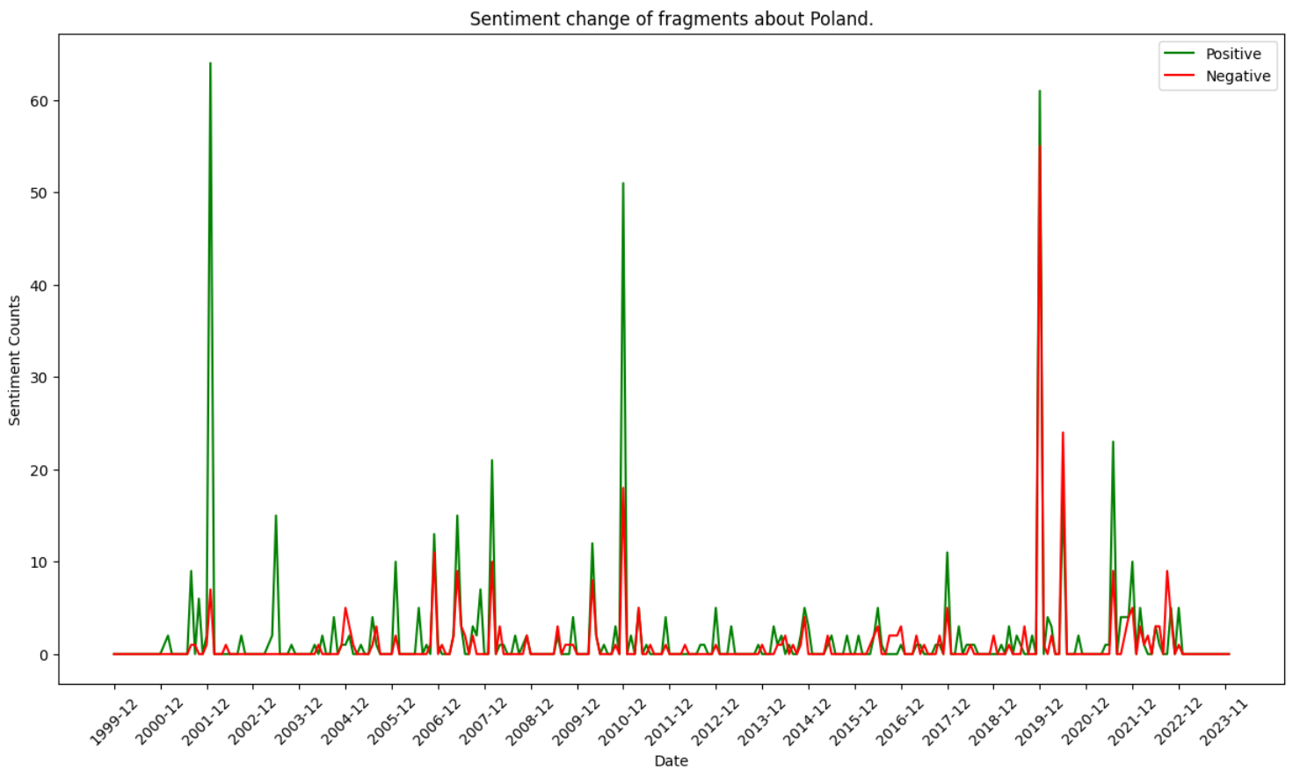
Sentiment Change in Fragments About Poland

Slide 15
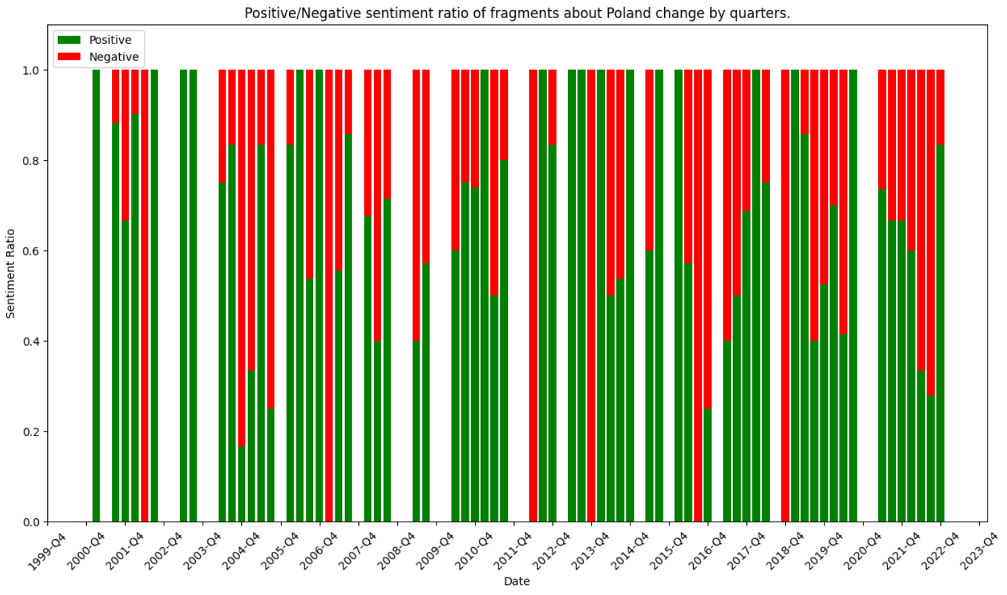
Sentiment Change in Fragments About Poland

Slide 16
Aspect Based Sentiment Analysis About Poland
Pipeline
NER using en_core_web_sm from SpaCy which extracts noun chunks from text.
Binary classification between positive and negative sentiment using the distilbert/distilbert-base-uncased-finetuned-sst-2-english.

Slide 17
Aspect Based Sentiment Analysis About Poland
Most Common Aspects
relation poland, russia poland, poles, poland, polish president, polish territory, polish people, polish colleague, russian polish relation, polish friend, polish government, polish foreign minister, poland romania

Slide 18
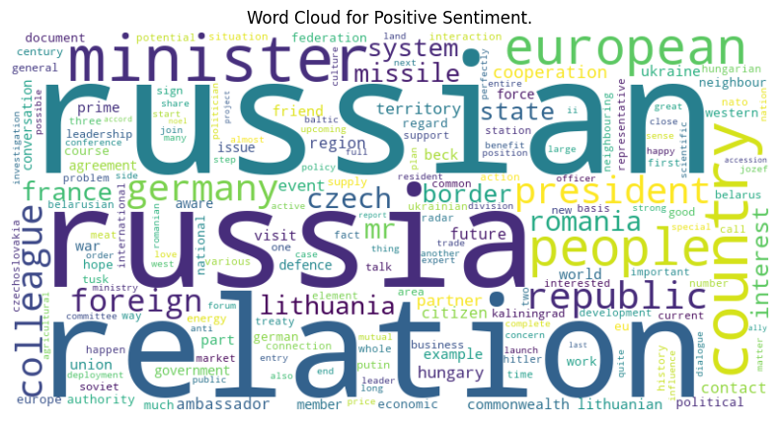
Aspect Based Sentiment Analysis About Poland
Positive Sentiment

Slide 19
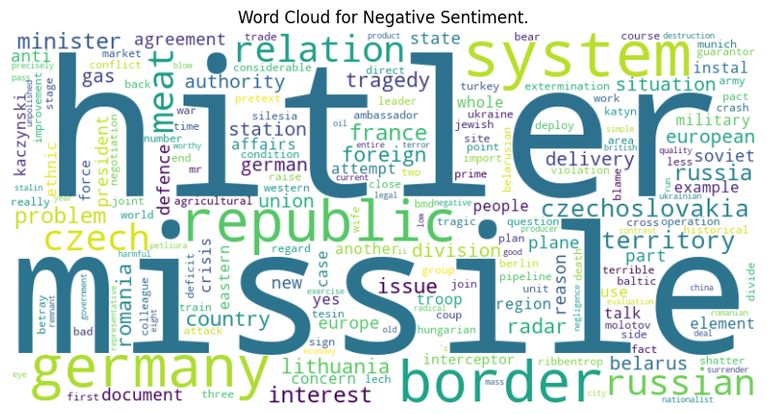
Aspect Based Sentiment Analysis About Poland
Negative Sentiment

Slide 20
Events Prediction Based on Sentiment Change
Methodology
Find positive and negative events which occurs between 1999 and 2015.
Prepare sentiment data for prediction by:
creating lagged features (with 1, 2, and 3 shifts),
calculating rolling mean with window=3.
Shift the target variable back by one month to predict events occurring in the following month.
Upsample observations with occurring events using SMOTE.
Perform train-test-split and train the model.

Slide 21
Events Prediction Based on Sentiment Change
Model
XGBoost Classifier with parameters:
n_estimators=10,
max_depth=2,
learning_rate=1,
objective='binary:logistic'

Slide 22
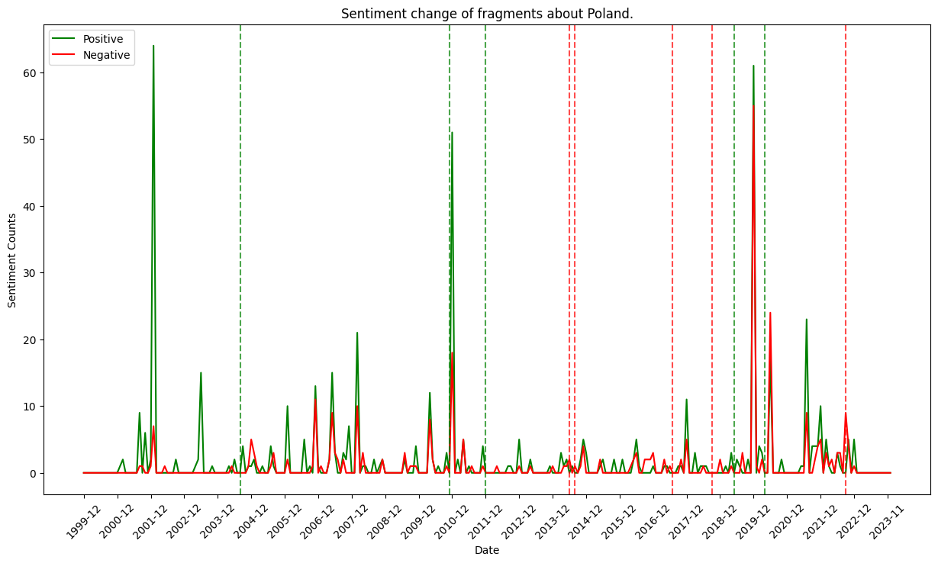
Events Prediction Based on Sentiment Change
Results

Slide 23
Thank you for attention!

